Slide 1
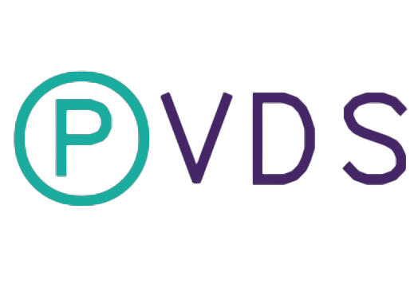

Slide 2
Phlebotomist’s Vein Detection system

Slide 3
Use Cases
The system has been optimized to detect veins in the arm and forearm regions
Training of medical staff, in particular Phlebotomists
Emergency situations where Venipuncture must be performed by an untrained individual
Identifying medical conditions such as Thrombosis and venous embolism

Slide 4
Benefits
Vastly speeding up routine Venipuncture procedures
Improving the ease and accuracy of Venipuncture procedure for Obese, infant and elderly individuals in addition to people of color
Low cost and ease of use

Slide 5
Live demonstration
Please observe:
Ease of use of software
Compatibility of software
Ease of use of hardware
Versatility of hardware
Image quality of final output

Slide 6
Image Processing
Raw image captured using external camera
Conversion of video frames to grayscale
Edge detection using Ai based algorithms
input
Output

Slide 7
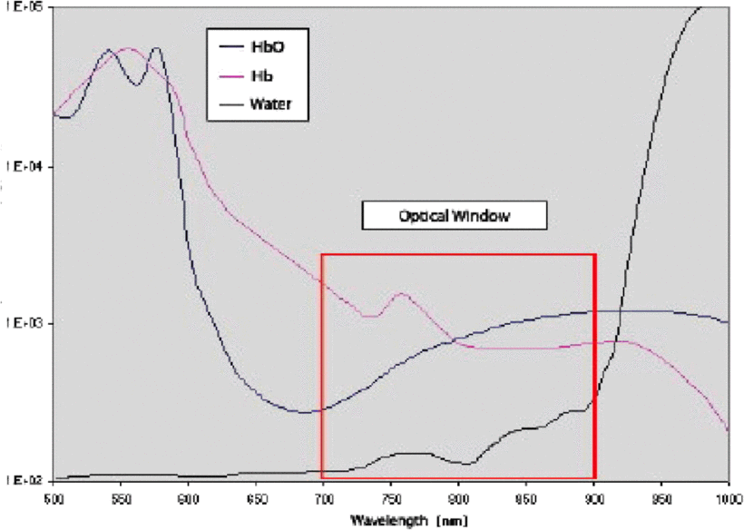
Working principle

